Slide 1
IOT Analytics In Health Monitoring (Iot+Analytics)

Slide 2
Presented By:
Jariwala DhruvKumar AjayKumar
Industry Mentor:
Name: Gnaneshwar Bandari
Designation: IoT & Robotics Engineer
Company Name: Smartbridge Education Services Pvt Ltd.
Contact Details: info@smartbridge.com

Slide 3
Outline of Presentation
 | Title of topic | Page No.
 | Definition | 4
2. | Introduction to Project | 5
3. | Block Diagram | 6
4. | Project Objectives | 7
5. | Hardware and Software | 8
6. | Sensor Details | 10
7. | Flowchart | 12
8. | Proof of Context | 13

Slide 4
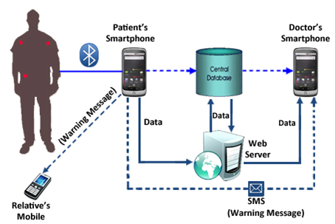
Definition
Title: IOT Analytics In Health Monitoring (IOT + Analytics)
Creating System Where the one System where all the IOT Device is connected with one Smart wearable device and send the data direct to the cloud and Monitor on android application.

Slide 5


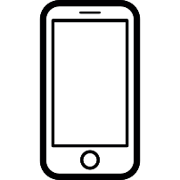
Introduction to Project
The health parameters of the person are monitored regularly by the temperature, pulse, BP sensors attached to the wearable device.
The wearable device is equipped with a Bluetooth module.
The sensor readings are uploaded to the Mobile app using Bluetooth communication.
The person should register along with their name, age, and gender in the Mobile app. The health condition of the person is uploaded to the cloud with their details and stored in the database.
There will be a machine learning model deployed in the cloud that can predict abnormal health diseases by taking the sensor values.
The sensor values from the database are sent to the machine learning model and the person will be notified with the predicted health condition.

Slide 6
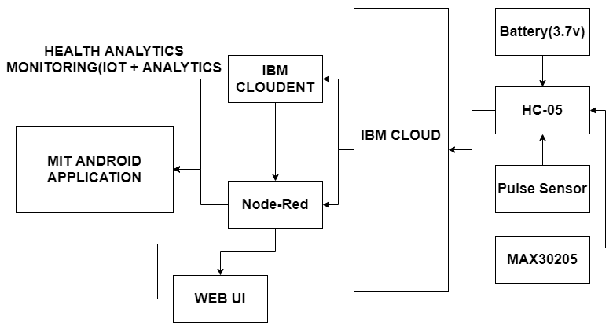
Block Diagram

Slide 7
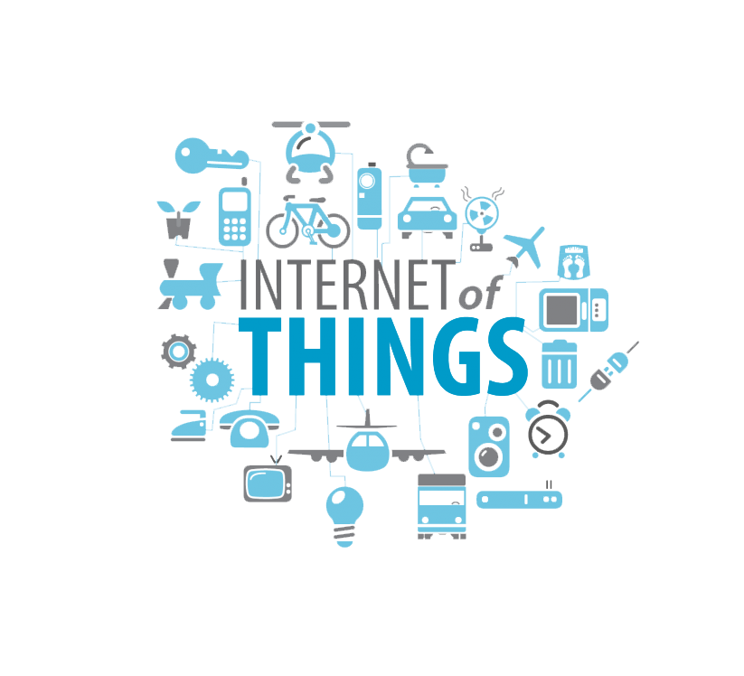
Project Objectives
The Aim of the Project is to create the system which have one Smart wearable Device which can scan your Body Temperature, Pulse and BPM which are shown on your mobile application.
The health parameters of the person are monitored regularly by the temperature, pulse, BP sensors attached to the wearable device.

Slide 8
Hardware and Software Designing
Hardware
NodeMCU with ESP8266 For Server Creation.
HC-05:- This Device Is Fixed in the Device which send the data and connected with mobile application
Pulse Sensor:- Sense the Pulse of the human and send the data to application.
MAX30205:- This Sensor Use to sense the temperature of the human body which are fix in Wearable device and send the data through the mobile application.

Slide 9
Hardware and Software Designing
Software
IBM Cloud:- Where the data is gone store in the Cloudent, IBM Watson and Node-Red
Internet of Things App:- This include in the IBM Cloud where we have to connect the Hardware using credentials.
Arduino IDE:- Upload and use the data on sensors by using software.
Node-Red:- This Connect the data by the software credentials.
IBM Watson:- Generate API key and authorization Token for the Connection.
Python 3.7:- Using this language and generate and create application for the device.
MIT Application:- Creating Android application.

Slide 10
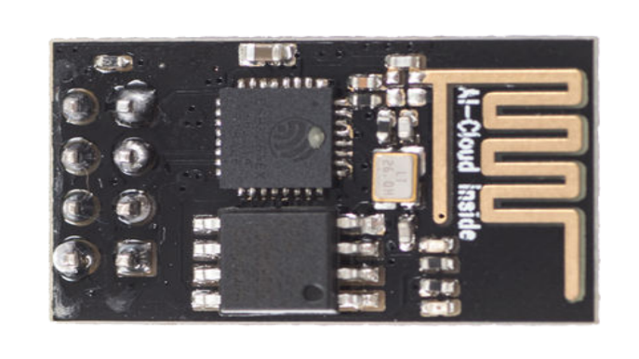
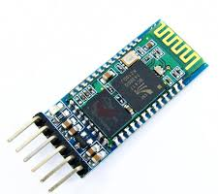
Sensor Details
HC-05
ESP8266
The Wireless Device which are connected to all device and send the data to IBM Cloud through the This Device.
This Device was fix in the wearable device which are mainly Bluetooth device which are connected with the mobile through Bluetooth.

Slide 11
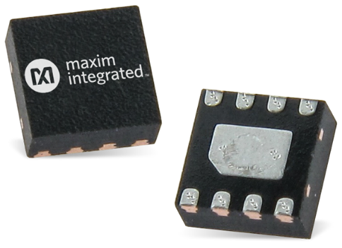
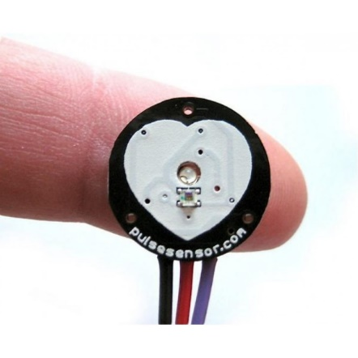
Sensor Details
MAX30205
Pulse Sensor
This Sensor Use to sense the temperature of the human body which are fix in Wearable device and send the data through the mobile application.
This Device is Connected to the NodeMCU and measure the data of the body and the send the data to mobile application.

Slide 12
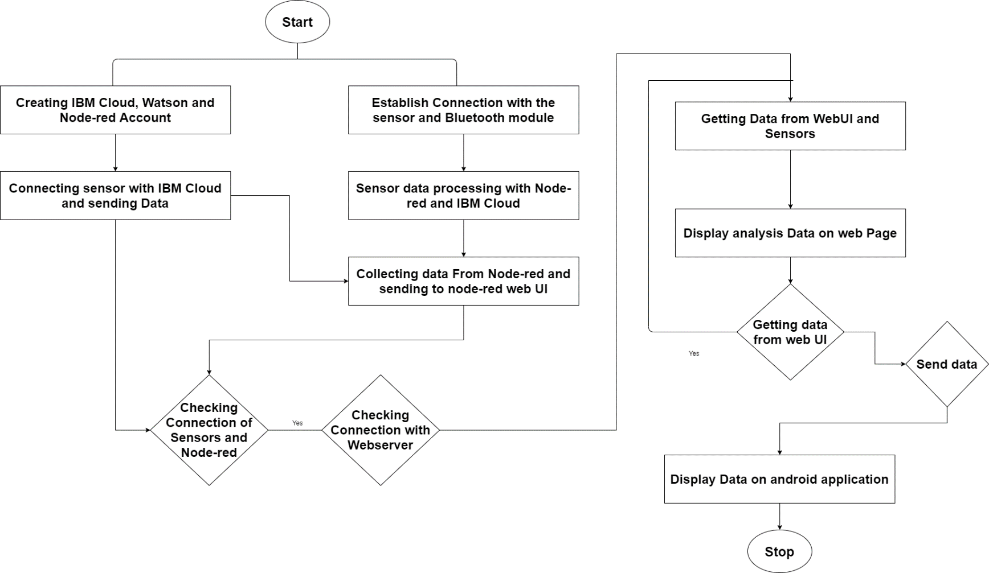
Flowchart

Slide 13
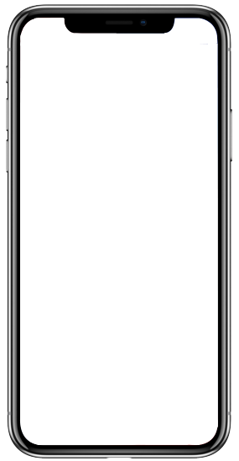
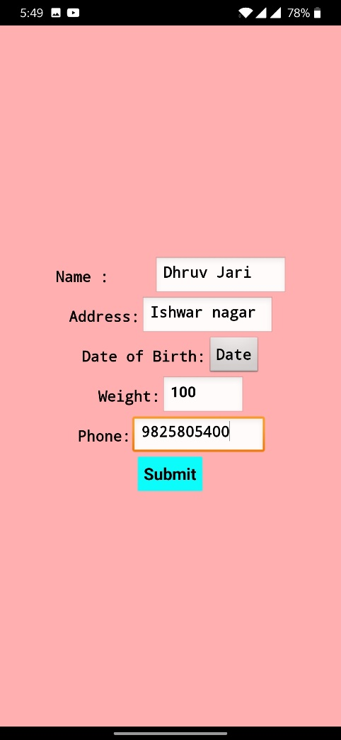
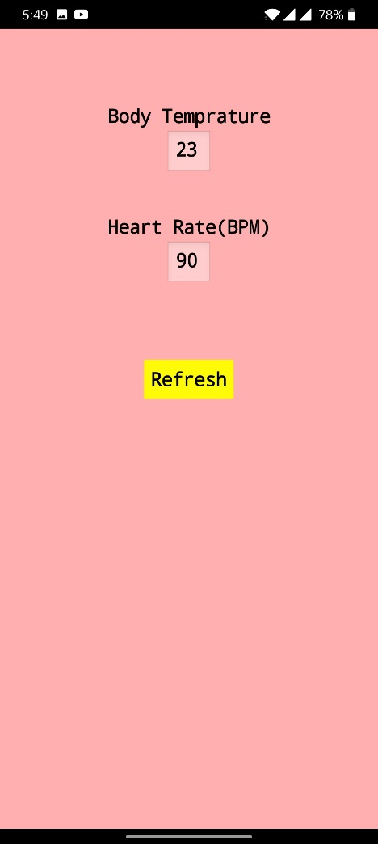
Proof of Context

Slide 14
Reference
https://smartbridge.teachable.com/
https://www.edureka.co/community/20945/python-code-to-retrieve-data-from-device-to-ibm-bluemix
http://watson-iot-sensor-simulator.mybluemix.net/
https://www.ibm.com/in-en/cloud
https://appinventor.mit.edu/
https://nodered.org/
https://www.python.org/

Slide 15


